Slide 1
Radial head fractures
Nyakure

Slide 2
Epidemiology
incidence
radial head fractures are among the most common elbow fractures
occur in up to 20% of all elbow injuries
Pathophysiology
mechanism of injury
fall on outstretched hand
forearm in pronated position
axial load created across elbow

Slide 3
Associated injuries
30 % have associated soft tissue or skeletal injuries including
distal radioulnar joint (DRUJ) injuries
interosseous membrane disruption
coronoid fractures
MCL/LCL injuries
Essex-Lopresti lesion (DRUJ) injury plus radial head fracture
elbow dislocation
terrible triad (elbow dislocation, radial head fx, coronoid fx)
carpal fractures

Slide 4
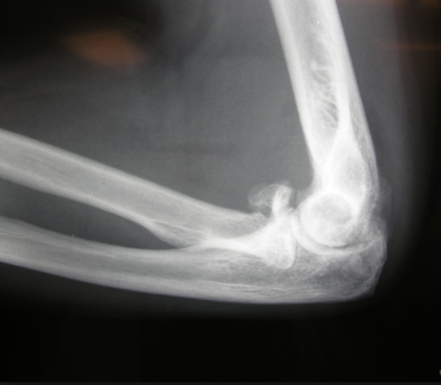
Image

Slide 5
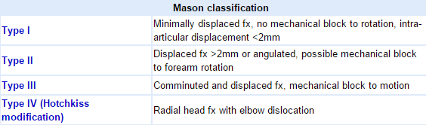
Classification

Slide 6
Clinical features
Symptoms
pain and tenderness along lateral aspect of elbow
limited elbow or forearm motion, particularly supination/pronation
Physical exam
ROM & instability
evaluate for mechanical blocks to flexion /extension at elbow and rotation of forearm
aspiration of joint hematoma and injection of local anesthesia aids in evaluation of mechanical block
examine varus and valgus stability at elbow
DRUJ stability
palpate wrist for pain and DRUJ stability, compare to contralateral side
palpate interosseous membrane for tenderness/pain

Slide 7
Imaging
Radiographs
recommended views
AP and lateral of the elbow
check for fat pad sign indicating possible minimally displaced fracture
additional view
radiocapitellar view (oblique lateral)
lateral view of elbow with tube angled at 45 degrees toward shoulder
helps detect subtle fractures of the radial head
CT
useful for comminuted fractures to further delineate fracture fragments

Slide 8
Nonoperative
short period of immobilization followed by early ROM
indications
isolated minimally displaced (less than 2mm) fxs with no mechanical blocks
outcomes
elbow stiffness with prolonged immobilization
good results in 85% to 95% of patients

Slide 9
Operative
ORIF
indications
Mason Type II with mechanical block
Mason Type III where ORIF feasible
mechanical block to motion
presence of other complex ipsilateral elbow injuries
outcomes
ORIF shown to have worse outcome with 3 or more fragments compared to ORIF with < 3 fragments
fragment excision (partial excision)
indications
fragments less than 25% of the surface area of the radial head or 25%-33% of capitellar surface area
outcomes
even small fragment excision may lead to instability

Slide 10
radial head replacement
indications
comminuted fractures (Mason Type III) with 3 or more fragments where ORIF not feasible
elbow fracture-dislocations or Essex Lopresti lesions
radial head excision will exacerbate elbow/wrist instability and may result in proximal radial migration and ulnocarpal impingement
outcomes
radial head fractures requiring replacement have shown good clinical outcomes with metallic implants

Slide 11
radial head resection
indications
low demand, sedentary patients
in a delayed setting for continued pain of an isolated radial head fracture
contraindications
presence of destabilizing injuries
forearm interosseous ligament injury (identify with radius pull test)
coronoid fracture
MCL deficiency
complications
pain
joint instability
proximal radial migration
decreased strength
cubitus valgus

Slide 12
Complications
Displacement of fracture
occurs in less than 5% of fractures
Posterior Interosseous nerve injury (with operative management)
Loss of fixation
Loss of forearm rotation
Elbow stiffness
First-line management incluides supervised exercise therapy with static or dynamic progressive elbow splinting over a 6 month period
Radiocapitellar joint arthritis
Infection

